Slide 1

Customer Analysis
2023
Nate Rodriguez, Jeffrey Marcopulos, Devin Keller, Andrea Colmignoli, Yuna Kim

Slide 2
Analysis Plan
Clean, then explore the data to establish an understanding for the variables and their connection with the dataset.
For each question, identify potential modeling methods.
Establish 2 or more approaches to each question.
Record the results of each method, selecting the most accurate/thorough approach.
Draw conclusions and interpret the results of each question in a meaningful manner.
Summarize key findings in a presentation, and include all other supporting information in the analysis write up.

Slide 3
Data Preparation
Load the two datasets and join them on common column, ID.
Created a new dataset with with all currencies transformed into USD.
Remove any entry with Purchase Amount above $1000 in order to rid the dataset of outliers.
This only omitted around 5% of the data.
Create new fields:
Amount USD - Represents the amount a user has spent in USD
Subscription Duration - Days between subscription start and end date
Email Open Rate - % of total emails a user opens
Email Click Rate - % of total emails that a user clicks the link
S Amount which represents the amount spend in USD

Slide 4
Most
Valued Subscribers
(Value Scoring Model)
01

Slide 5
Method and Feature Engineering
Utilize key variables to “score” each user in terms of value.
Value Scoring Model:
Purchase Amount USD - Total amount user has spent in USD.
Subscription Duration - Length of user subscription
Total Sessions - Total Number of session a user has done
Normalized 'Subscription Duration', 'Purchase Amount USD', and 'Total Number of Sessions' columns using MinMaxScaler, which scales the values to a range between 0 and 1.

Slide 6
Weight Adjustments
Because certain fields such as purchase amount are more important than others, we adjust the weight these fields impacted the value score.
Purchase Amount USD: 50%
Subscription Duration: 25%
Total Sessions: 25%
User Value = .5(Purchase Amount) + .25 (Subscription Duration) + .25(Total Number of Sessions)

Slide 7
Most Valuable Subscribers
In the end, the users that were in the top 10% of value score where considered to be our most valuable subscribers.

Slide 8
Subscriber Segments
02

Slide 9


Methods Used
GGplot Visualizations to identify trends.
Tabulation analysis and numerical summaries of language type, country origin, platform type, and subscription type
Power Bi: Dashboard to deeper understand segments.

Slide 10
Segment Overview
Platform Type
Country of Origin
Subscription Type
Language
IOS (48.1%)
Android (21.9%)
Web (30.0%)
US/Canada (62.4%)
Europe (28.3%)
Other (9.3%)
Lifetime (20.9%)
Limited (79.1%)
30 different languages
Most popular Languages:
Spanish, English, French
Power Bi Dashboard To Explore Further (Next Page)

Slide 11
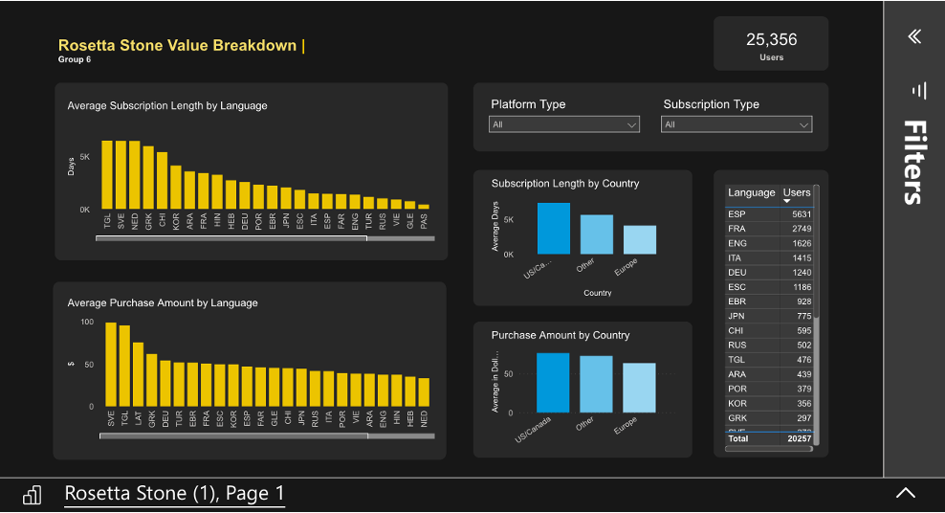
Analysis Results
Key Findings
Languages TGL, SVE are attractive customers due to their high purchase amounts and long subscription lengths.
US/Canada users tend to spend more, and subscribe longer than other countries.
IOS and lifetime users are more attractive than their segment counterparts.

Slide 12
Subscribers to Sell Additional Products To
03

Slide 13
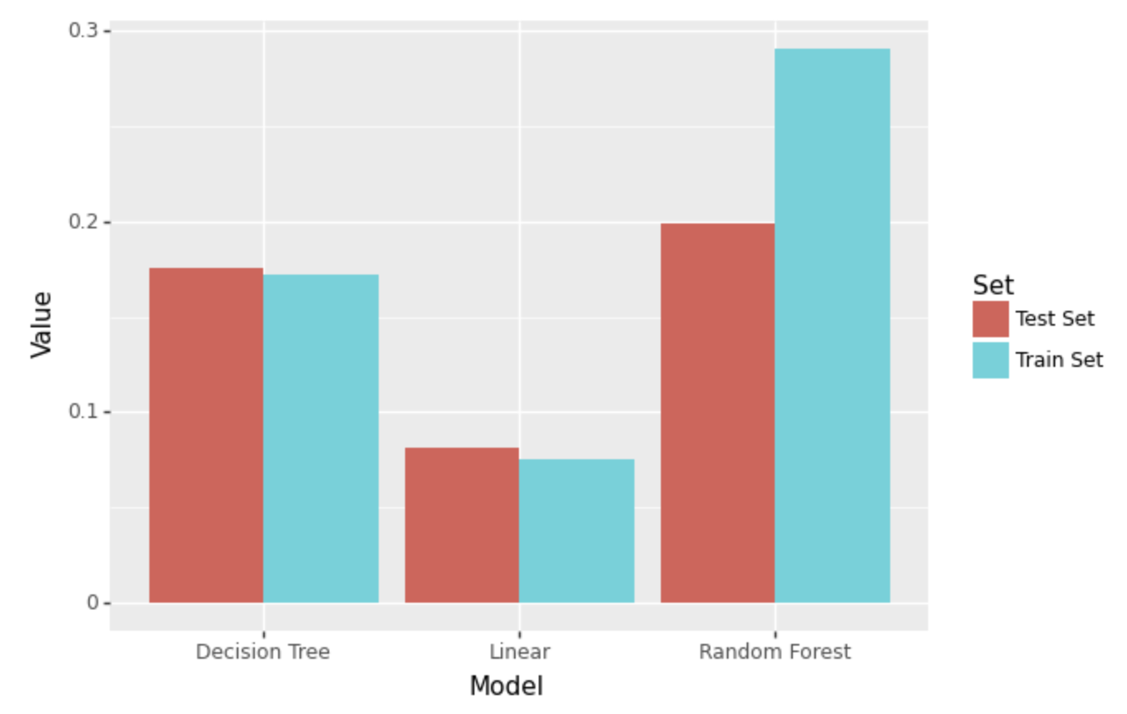
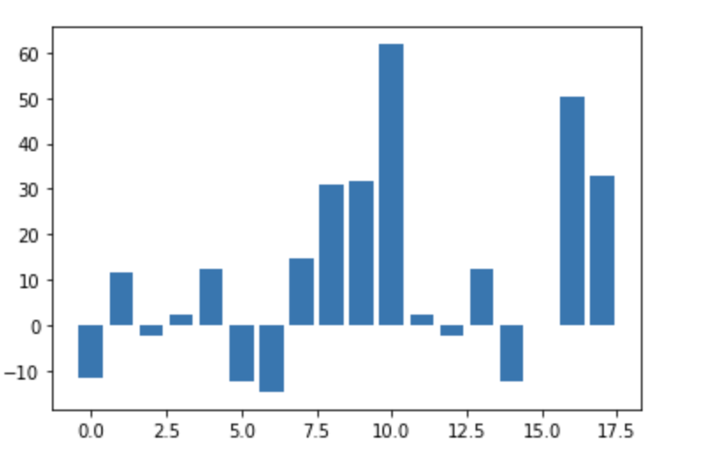
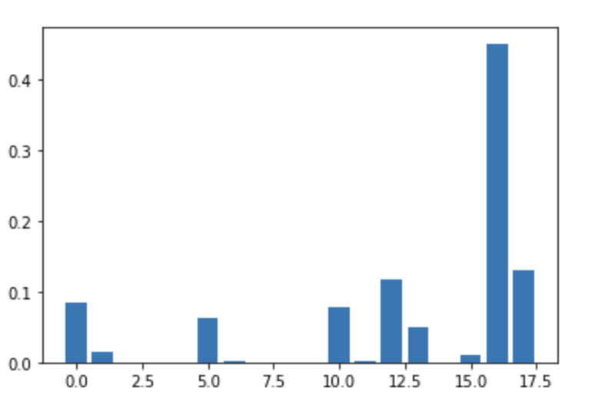
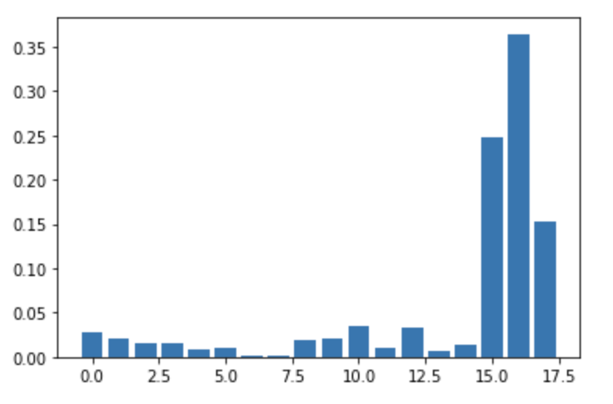
Regression Models
Target variable: Purchase Amount USD
Models Created: Linear Regression, Decision Tree Regression, Random Forest Regression
Results: 'App Engagement' and 'Open Rate' are the common important variables when predicting purchase amount.

Slide 14
K-Means Model
Segment the data based on four key variables in order to identify users to sell more products/services to
Variables Used:
Total Sessions
Completed Lessons
Email Open Rate
Email Click Rate
Hyper-parameters:
Using the elbow method, we identified that the optimal number of clusters was 3.
We selected these variables to identify users who frequently use the app (Sessions and Lessons), and are currently engaging with marketing efforts (Email engagements).

Slide 15
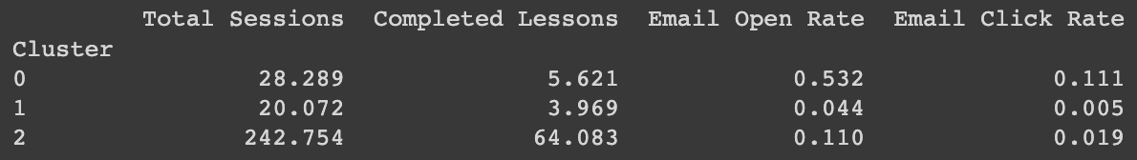
Cluster Results
Interpretation:
Cluster 0:
High Email Open and Click Rate, mid-tier lesson completion, mid-tier total sessions.
Determined that Cluster #0 is optimal because that is cluster of people who are both using the app frequently and they are engaging with marketing efforts.
Cluster 1:
Low Email Open and Click Rate, low lesson completion, low total sessions.
Cluster 2:
Mid-tier Email Open and Click Rate, high lesson completion, high total sessions.

Slide 16
Churning Subscriber Type and Barriers to Engagement
04

Slide 17
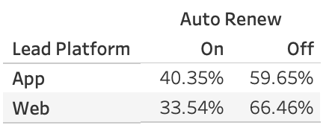
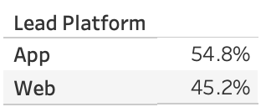
Identifying and Interpreting Churn
Assumption: Users who have turned auto renew off are users that are likely to not continue their usage of Rosetta Stone.
App users are 7% more likely to keep auto renew on compared to web users.
This suggests that Rosetta stone is geared more towards app users. This is a barrier because 45% of Rosetta users are Web users and suggests if Rosetta Stone can improve their website application they can help convert more of theses users to auto renew.

Slide 18
Relevant Business Opportunities
05

Slide 19
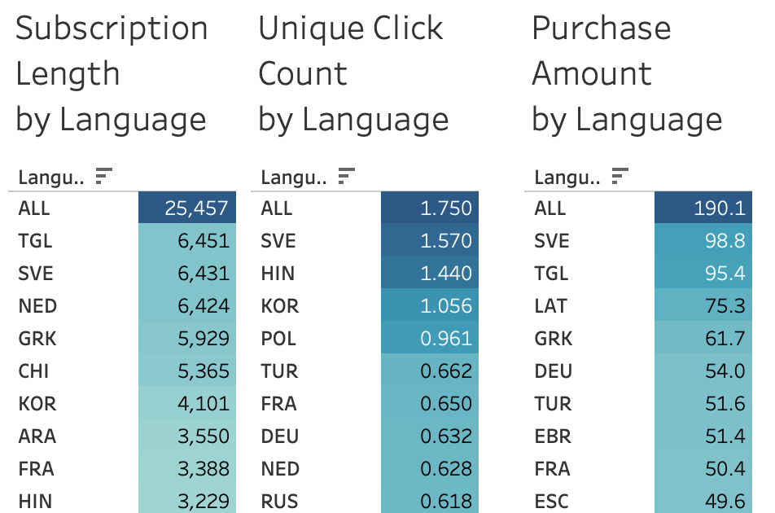
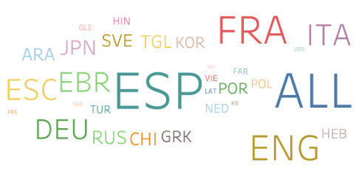
Opportunities
Most customers do not have Lifetime subscriptions which leaves potential engagement and money on the table.
Despite being the most used language, Spanish (ESP) is not a top performer in the target categories indicating a potential problem in the course.
English (ENG) is another popular language that does not encourage high purchase amounts or long subscriptions
Next Steps: find ways to pull more monetary value from the more popular courses.

Slide 20
Thank You

